Slide 1
Security
Chapter 16

Slide 2
Objectives
1
2
Security Principles
Authentication
3
4
Cryptography
HTTPS
5
6
Security Best Practices
Common Threat Vectors

Slide 3
Security Principles
Section 1 of 6

Slide 4
Security Overview
The right way of addressing security is right from the beginning and all along the way so that you can plan for a secure system and hopefully have one in the end.
Not only is a malicious hacker on a tropical island a threat but so too is a sloppy programmer, a disgruntled manager, or a naive secretary.
Since websites are an application of networks and computer systems, you must draw from those disciplines to learn many foundational security ideas.

Slide 5
Information Security
The CIA Triad
Information security is the holistic practice of protecting information from unauthorized users. Computer/IT security is just one aspect of this holistic thinking, which addresses the role computers and networks play.
The other is information assurance, which ensures that data is not lost when issues do arise.

Slide 6
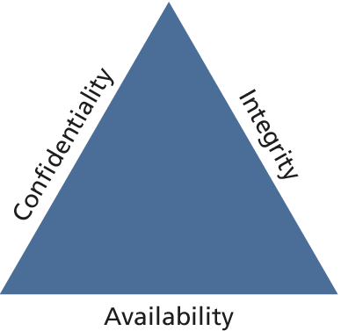
Information Security
The CIA Triad

Slide 7
Information Security
The CIA Triad
Confidentiality is the principle of maintaining privacy for the data you are storing, transmitting, etc.
This is the concept most often thought of when security is brought up.
Integrity is the principle of ensuring that data is accurate and correct.
This can include preventing unauthorized access and modification, but also extends to disaster preparedness and recovery.
Availability is the principle of making information available when needed to authorized people.
It is essential to making the other two elements relevant, since without it, it’s easy to have a confidential and integral system (a locked box).

Slide 8
Security Standards
This is really serious stuff
In addition to the triad, there are ISO standards ISO/IEC 27002-270037 that speak directly (and thoroughly) about security techniques and are routinely adopted by governments and corporations the world over.
These standards are very comprehensive, outlining the need for risk assessment and management, security policy, and business continuity to address the triad.
This chapter touches on some of those key ideas that are most applicable to web development.

Slide 9
Risk Assessment and Mangement
Risk assessment uses the concepts of
actors,
impacts,
threats, and
vulnerabilities
to determine where to invest in defensive countermeasures.

Slide 10
Actors
The three amigos
Internal actors are the people who work for the organization. Although they account for a small percentage of the attacks, they are especially dangerous due to their internal knowledge of the systems.
External actors are the people outside of the organization. It turns out that more than three quarters of external actors are affiliated with organized crime or nation states.
Partner actors are affiliated with an organization that you partner or work with. Quite often partners are granted some access to each other’s systems (to place orders, for example).

Slide 11
Impact
what systems were infiltrated and what data was stolen or lost?
A loss of availability prevents users from accessing some or all of the systems.
This might manifest as a denial of service attack, or a SQL injection attack (described later), where the payload removes the entire user database, preventing logins from registered users.
A loss of confidentiality includes the disclosure of confidential information to a (often malicious) third party.
This could manifest as a cross-site script attack where data is stolen right off your screen or a full-fledged database theft where credit cards and passwords are taken.
A loss of integrity changes your data or prevents you from having correct data.
This might manifest as an attacker hijacking a user session, perhaps placing fake orders or changing a user’s home address.

Slide 12
Threats
STRIDE
A threat refers to a particular path that a hacker could use to exploit a vulnerability and gain unauthorized access to your system.
A flood destroying your data center is a threat just as much as malicious SQL injections, buffer overflows, denial of service, and cross-site scripting attacks.

Slide 13
Threats
Categorize threats with Stride
Spoofing – The attacker uses someone else’s information to access the System.
Tampering – The attacker modifies some data in nonauthorized ways.
Repudiation – The attacker removes all trace of their attack, so that they cannot be held accountable for other damages done.
Information disclosure – The attacker accesses data they should not be able to.
Denial of service – The attacker prevents real users from accessing the systems.
Elevation of privilege – The attacker increases their privileges on the system thereby getting access to things they are not authorized to do.

Slide 14
Vulnerabilities
The holes in your armor
Once vulnerabilities are identified, they can be assessed for risk.
Some vulnerabilities are not fixed because they are unlikely to be exploited, while others are low risk because the consequences of an exploit are not critical.
The top five classes of web vulnerability are:
Injection
Broken authentication and session management
Cross-site scripting
Insecure direct object references
Security misconfiguration

Slide 15
Assessing Risk
Putting it all together
For our purposes, it will suffice to summarize that in risk assessment you would begin by identifying the actors, vulnerabilities, and threats to your information systems.
The probability of an attack, the skill of the actor, and the impact of a successful penetration are all factors in determining where to focus your security efforts.

Slide 16
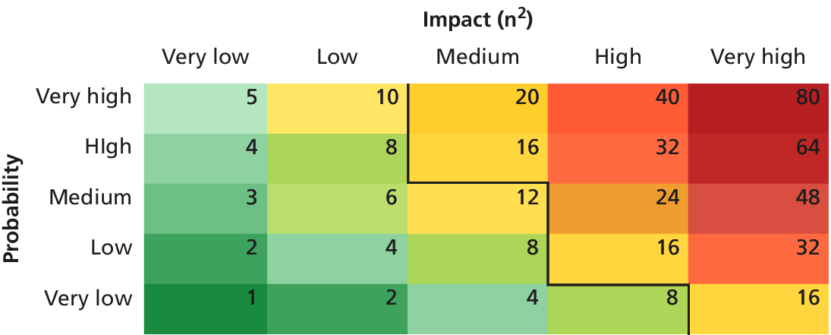
Assessing Risk
A visual way of assessing threats

Slide 17
Policies
One part of your defenses
Usage policy defines what systems users are permitted to use, and under what situations. A company may, for example, prohibit social networking while at work. Usage policies are often designed to reduce risk by removing some attack vector.
Authentication policy controls how users are granted access to the systems.
Legal policies define a wide range of things including data retention and backup policies as well as accessibility requirements (like having all public communication well organized for the blind).

Slide 18
Policies
Please don’t make me change my password every day
Password policies can stipulate
the characteristics of acceptable passwords, and
expiration of passwords.
Ironically, draconian password policies introduce new attack vectors, nullifying the purpose of the policy at the first place.
Where authentication is critical, two-factor authentication should be applied in place of password policies that do not increase security.

Slide 19
Business Continuity
There is material enough for an entire courses here
Part of a secure system is being able to access it in the case of the unforeseen. You should consider
Administrator Password Management
Backups and Redundancy
Geographic Redundancy
Stage Mock Events
Auditing you systems

Slide 20
Secure By Design
People are bad
Secure by design addresses that there are malicious users out there. By continually distrusting user input (and even internal values) throughout the design and implementation phases, you will produce more secure software than if you didn’t consider security at every stage.
Techniques can be applied at every stage of the software development life cycle to make your software Secure By Design.

Slide 21
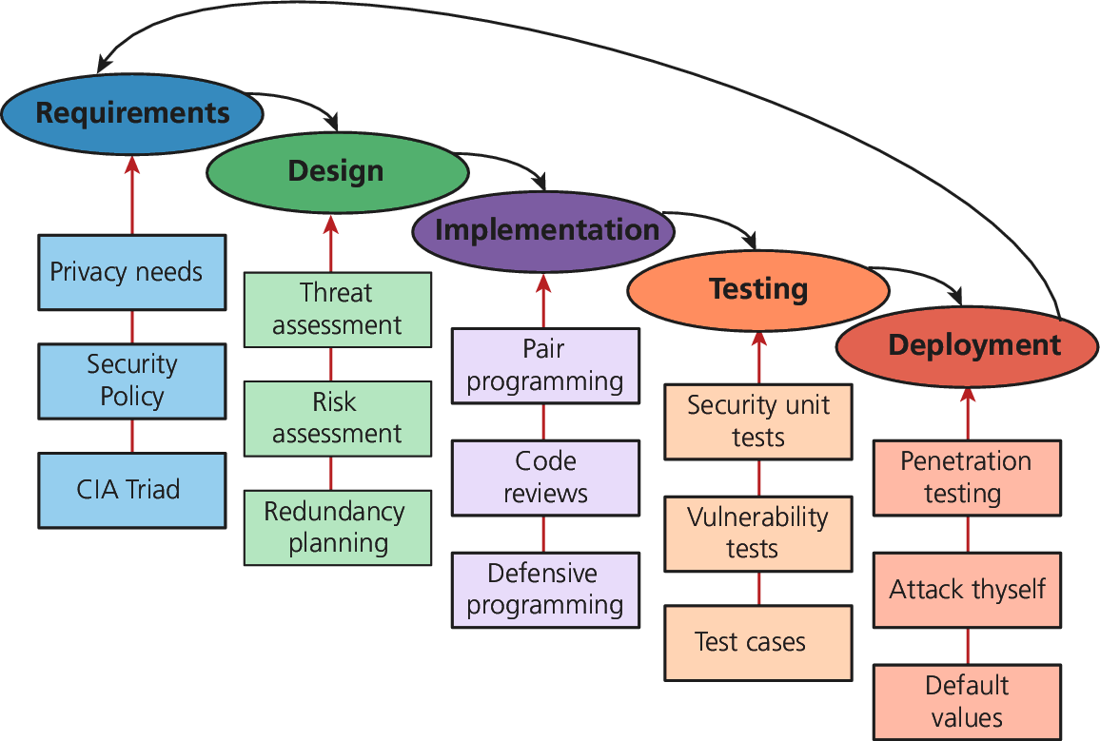
Secure By Design
Here’s what we do

Slide 22
Secure By Design
Code Reviews
In a code review system, programmers must have their code peer-reviewed before committing it to the repository.
In addition to peer-review, new employees are often assigned a more senior programmer who uses the code review opportunities to point out inconsistencies with company style and practice.

Slide 23
Secure By Design
Unit Testing
Unit testing is the principle of writing small programs to test your software as you develop it. Usually the units in a unit test are a module or class, and the test can compare the expected behavior of the class against the actual output.
If you break any existing functionality, a unit test will discover it right away, saving you future headache and bugs.

Slide 24
Secure By Design
Pair Programming
Pair programming is the technique where two programmers work together at the same time on one computer.
One programmer drives the work and manipulates the mouse and keyboard while
the other programmer can focus on catching mistakes and high-level thinking.
After a set time interval the roles are switched and work continues.
Like a continuous code review.

Slide 25
Secure By Design
Security Testing
Security testing is the process of testing the system against scenarios that attempt to break the final system.
It can also include penetration testing where the company attempts to break into their own systems to find vulnerabilities as if they were hackers.
Whereas normal testing focuses on passing user requirements, security testing focuses on surviving one or more attacks that simulate what could be out in the wild.

Slide 26
Secure By Design
Secure by Default
Systems are often created with default values that create security risks (like a blank password).
Secure by default aims to make the default settings of a software system secure, so that those type of breaches are less likely even if the end users are not very knowledgeable about security.

Slide 27
Social Engineering
In Computer Security
Social engineering is the human part of information security that increases the effectiveness of an attack.
No one would click a link in an email that said:
click here to get a virus,
but they might click a link to:
get your free vacation.

Slide 28
Social Engineering
Phising
Phishing scams such as the Spanish Prisoner or Nigerian Prince Scams. Users might be tricked into disclosing information or even sending money in the hopes of freeing up even more.
Good defenses include:
spam filters
good policies, with users trained not to click links in emails
Some organizations go so far as to set up false phishing scams that target their own employees to see which ones will divulge information to such scams. Those employees are then etrained orterminated.

Slide 29
Security Theater
Nothing to see here folks
Security theater is when visible security measures are put in place without too much concern as to how effective they are at improving actual security.
This is often done in 404 pages where a stern warning might read:
Your IP address is XX.XX.XX.XX. This unauthorized access attempt has been logged. Any illegal activity will be reported to the authorities.

Slide 30
Authentication
Section 2 of 6

Slide 31
Authentication
Authentication is the process by which you decide that someone is who they say they are and therefore permitted to access the requested resources.
Whether
getting entrance to an airport,
getting past the bouncer at the bar, or
logging into your web application,
you have already seen authentication in action.

Slide 32
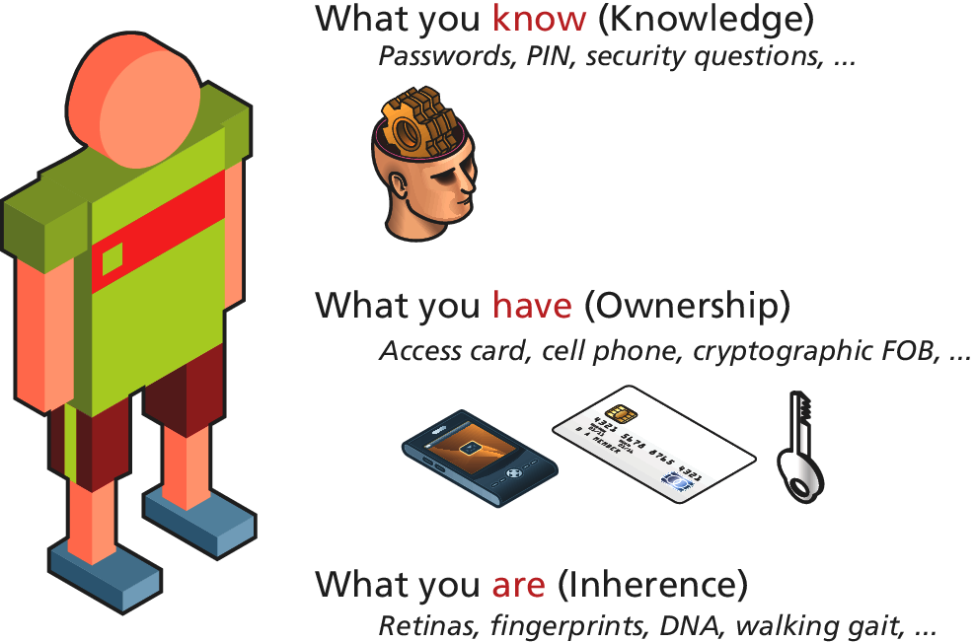
Authentication Factors
the things you can ask someone for
Authentication factors are the things you can ask someone for in an effort to validate that they are who they claim to be.

Slide 33
Authentication Factors
the things you can ask someone for
Knowledge factors are the things you know
Passwords, PIN, Challenge Question
Ownership factors are the things that you possess
Key, FOB, Card, Mobile Phone
Inherence factors are the things you are
Fingerprint, signature, DNA, gait

Slide 34
Single Factor Authentication
How many factors do you need?
Single-factor authentication is the weakest and most common category of authentication system where you ask for only one of the three factors.
Know a password
Posses an access card
Fingerprint access on your mobile phone
When better authentication confidence is required, more than one authentication factor should be considered

Slide 35
Multi Factor Authentication
More than one.
Multifactor authentication is where two distinct factors of authentication must pass before you are granted access.
The way we all access an ATM machine is an example of two-factor authentication:
you must have both the knowledge factor (PIN) and
the ownership factor(card)
Multifactor authentication is becoming prevalent in consumer products as well:
your cell phone is used as the ownership factor alongside
your password as a knowledge factor.

Slide 36
Third Party Authentication
Let someone else worry about it
Many popular services allow you to use their system to authenticate the user and provide you with enough data to manage your application.
Third-party authentication schemes like OpenID and oAuth are popular with developers and are used under the hood by many major websites including Amazon, Facebook, Microsoft, and Twitter, to name but a few.

Slide 37
OAuth
3rd party Authentication requires some effort
OAuth uses four user roles
The resource owner is normally the end user who can gain access to the resource (though it can be a computer as well).
The resource server hosts the resources and can process requests using access tokens.
The client is the application making requests on behalf of the resource owner.
The authorization server issues tokens to the client upon successful authentication of the resource owner. Often this is the same as the resource server.

Slide 38
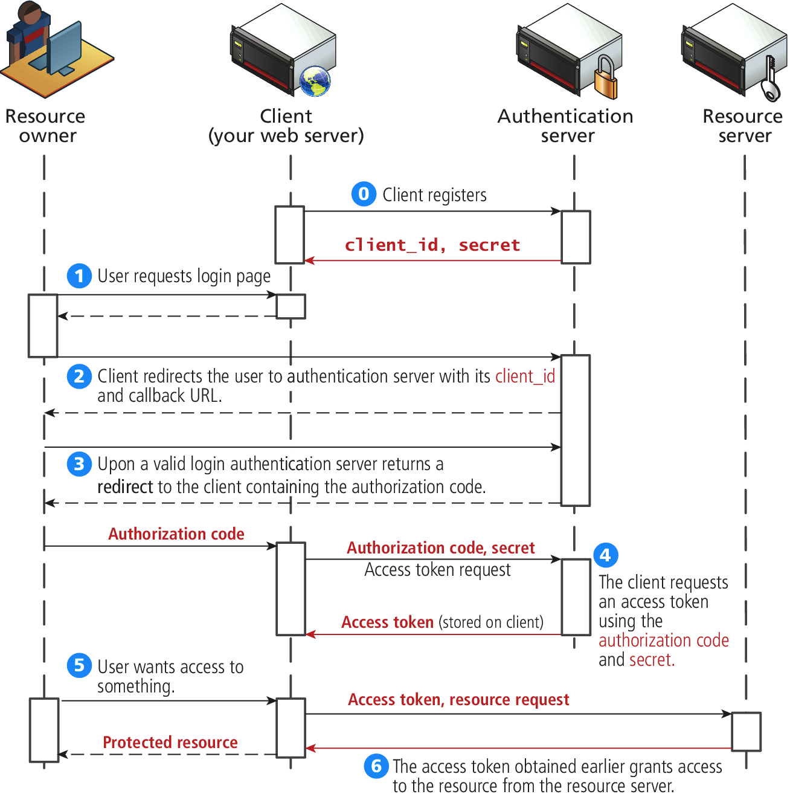
OAuth
An overview

Slide 39
Authorization
Not the same as authentication
Authorization defines what rights and privileges a user has once they are authenticated.
Authentication grants access
vs
Authorization defines what the user with access can (and cannot) do.
The principle of least privilege is a helpful rule of thumb that tells you to give users and software only the privileges required to accomplish their work.

Slide 40
Authorization
Not the same as authentication
Some examples in web development where proper authorization increases security include:
Using a separate database user for read and write privileges on a database
Providing each user an account where they can access their own files securely
Setting permissions correctly so as to not expose files to unauthorized users
Ensuring Apache is not running as the root account

Slide 41
Cryptography
Section 3 of 6

Slide 42
Cryptography
Secret Messages
Being able to send a secure message has been an important tool in warfare and affairs of state for centuries.
At a basic level we are trying to get a message from one actor (we will call her Alice), to another (Bob), without an eavesdropper (Eve) intercepting the message.
Since a single packet of data is routed through any number of intermediate locations on its way to the destination, getting your data (and passwords) is as simple as reading the data during one of the hops unless you use cryptography.

Slide 43
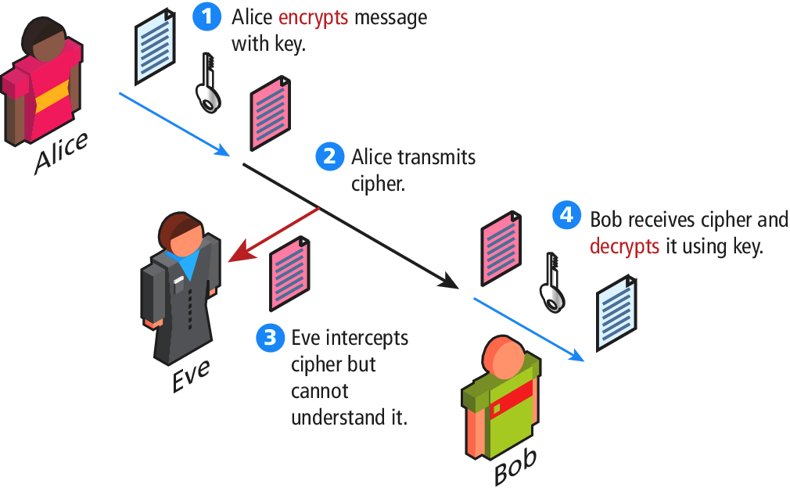
Cryptography
The goal

Slide 44
Cryptography
Some key terms
A cipher is a message that is scrambled so that it cannot easily be read, unless one has some secret key.
The key can be a number, a phrase, or a page from a book.
What is important in both ancient and modern cryptography is to keep the key a secret between the sender and the receiver.

Slide 45
Cryptography
Substitution ciphers
A substitution cipher is one where each character of the original message is replaced with another character according to the encryption algorithm and key.
Caesar
Vigenere
One Time Pad
Modern Block Ciphers

Slide 46
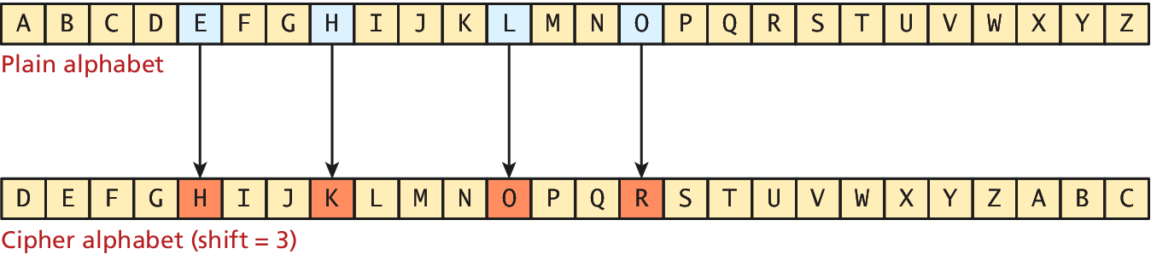
Caesar
Substitution ciphers
The Caesar cipher, named for and used by the Roman Emperor, is a substitution cipher where every letter of a message is replaced with another letter, by shifting the alphabet over an agreed number (from 1 to 25).
The message HELLO, for example, becomes KHOOR when a shift value of 3 is used

Slide 47
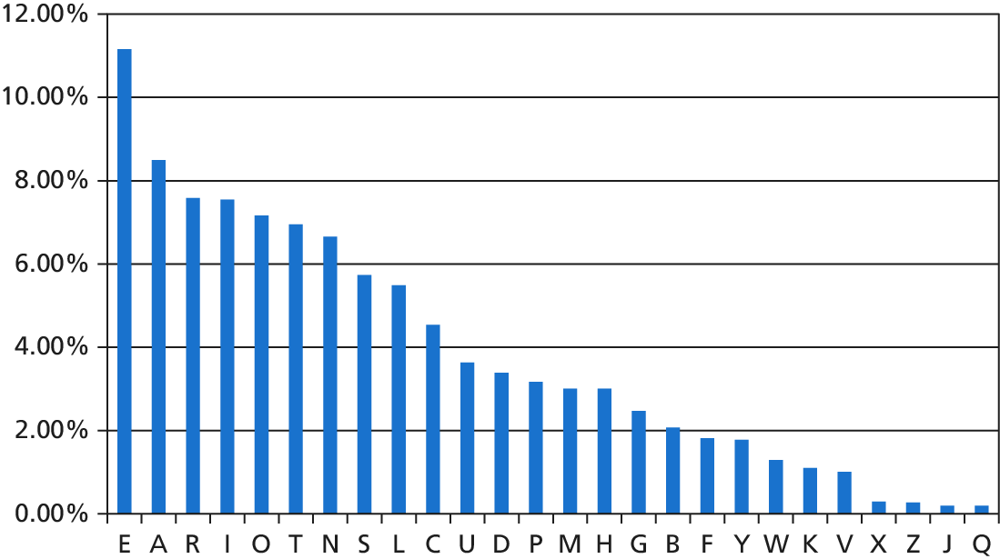
The problem with lousy ciphers
Letter distribution is not flat
The frequency of letters (and sets of two and three letters) is well known
If you noticed the letter J occurring most frequently, it might well be the letter E

Slide 48
The problem with lousy ciphers
Letter distribution is not flat
Any good cipher must therefore try to make the resulting cipher text letter distribution relatively flat so as to remove any trace of the telltale pattern of letter distributions.
Simply swapping one letter for another does not do that, necessitating other techniques.

Slide 49
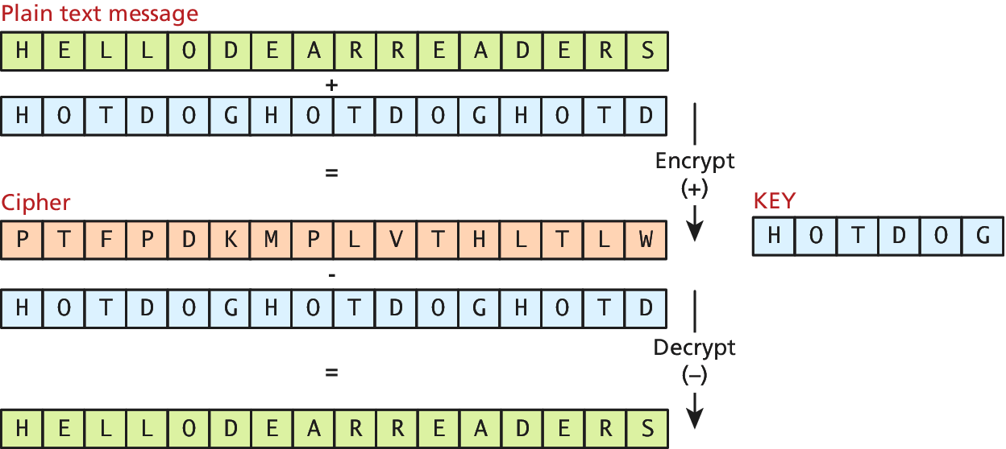
Vigenère
Early attempt to flatten letter distribution of ciphers
The Vigenère cipher, named for the sixteenth-century cryptographer, uses a keyword to encode a message.
The key phrase is written below the message and the letters are added together to form the cipher text as illustrated

Slide 50
One Time Pad
Vigenere with an infinitely long key
The one-time pad refers to a perfect technique of cryptography where Alice and Bob both have identical copies of a very long sheet of numbers, randomly created
Claude Shannon famously proved that the one-time pad is impossible to crack
However, it is impractical to implement on a large scale and remains a theoretical benchmark that is rarely applied in practice.

Slide 51
Modern Block Ciphers
Ciphers in the computer age
block ciphers encrypt and decrypt messages using an iterative replacing of a message with another scrambled message using 64 or 128 bits at a time.
The Data Encryption Standard (DES) and its replacement,
The Advanced Encryption Standard (AES)
Are two-block ciphers still used in web encryption today

Slide 52
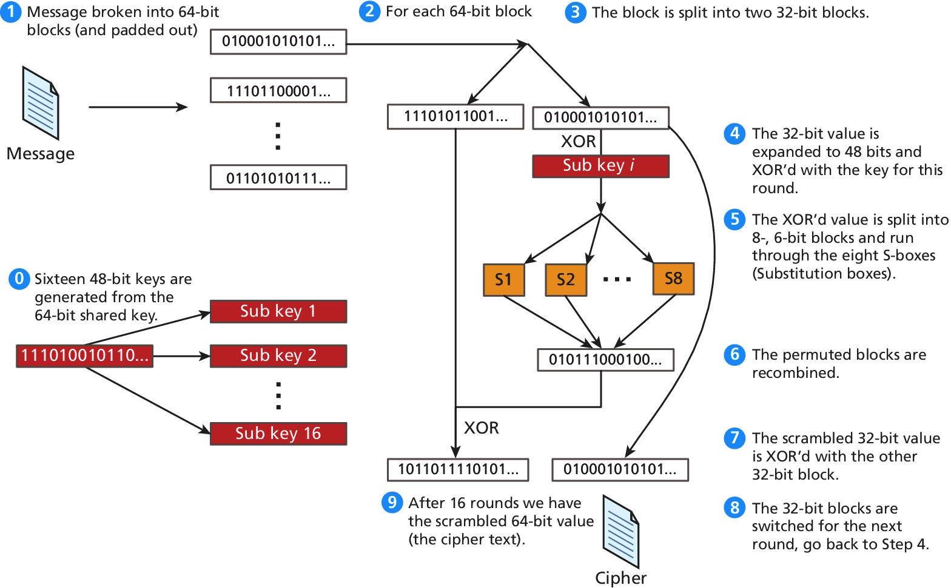
DES illustration
Pretty simple, no?

Slide 53
Symmetric Key Problem
How to exchange the key?
All of the ciphers we have covered thus far use the same key to encode and decode, so we call them symmetric ciphers.
The problem is that we have to have a shared private key. How?
Over the phone?
In an email?
Through the regular mail?
In person?

Slide 54
Diffie-Hellman key exchange
Solves the problem of key exchange
Not used extensively anymore but the mathematics of the Diffie-Hellman key exchange are accessible to a wide swath of readers.
Modern algorithms (like RSA) apply similar thinking but with more complicated mathematics.

Slide 55
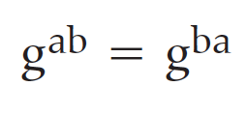
Diffie-Hellman key exchange
Solves the problem of key exchange
The algorithm relies on the power associative rule, which states that:
g^{ab} can be used as a symmetric key for encryption, but since only gª and g^{b} are transmitted the symmetric key isn’t intercepted.

Slide 56
Diffie-Hellman key exchange
Solves the problem of key exchange
To set up the communication, Alice and Bob agree to a prime number p and a generator g for the cyclic group modulo p.
Alice then chooses an integer a, and sends the value gª mod p to Bob.
Bob also chooses a random integer b and sends g^{b} mod p back to Alice.
Since g^{ab} = g^{ba}, Bob and Alice now have a shared secret key that can be used for symmetric encryption algorithms such as DES or AES.

Slide 57
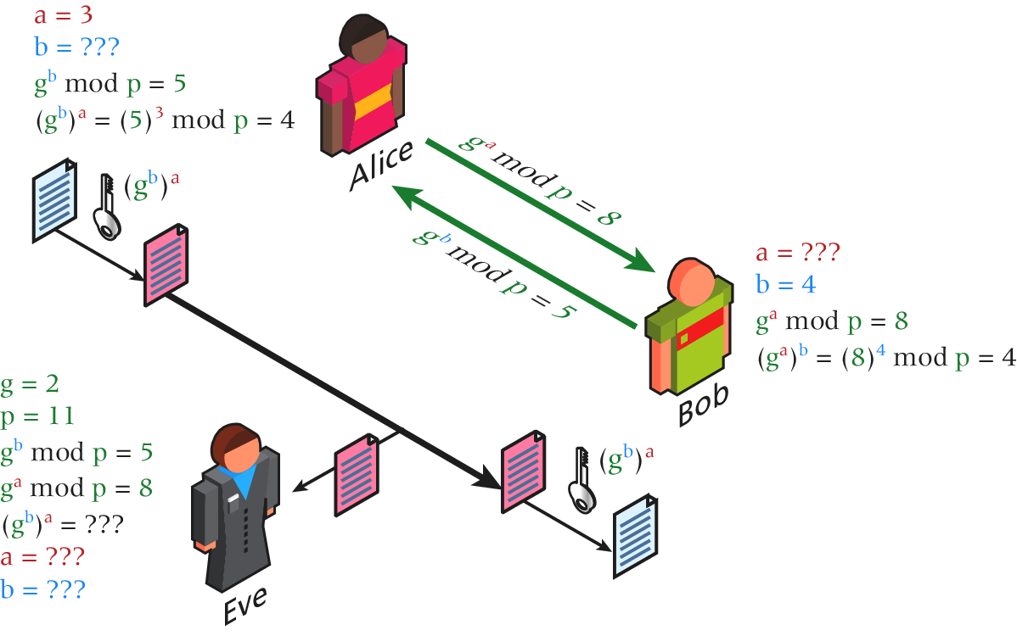
Diffie-Hellman key exchange
Solves the problem of key exchange

Slide 58
Public Key Cryptography
Solves the problem of key exchange
Public key cryptography (or asymmetric cryptography) solves the problem of the secret key by using two distinct keys:
a public one, widely distributed
another one, kept private
Algorithms like the Diffie-Hellman key exchange allow a shared secret to be created out in the open, despite the presence of an eavesdropper

Slide 59
Digital Signatures
Confirming the sender is authentic
A digital signature is a mathematically secure way of validating that a particular digital document was
created by the person claiming to create it (authenticity),
Was not modified in transit (integrity),
and cannot be denied (non-repudiation).
The process of signing a digital document can be as simple as encrypting a hash of the transmitted message.

Slide 60
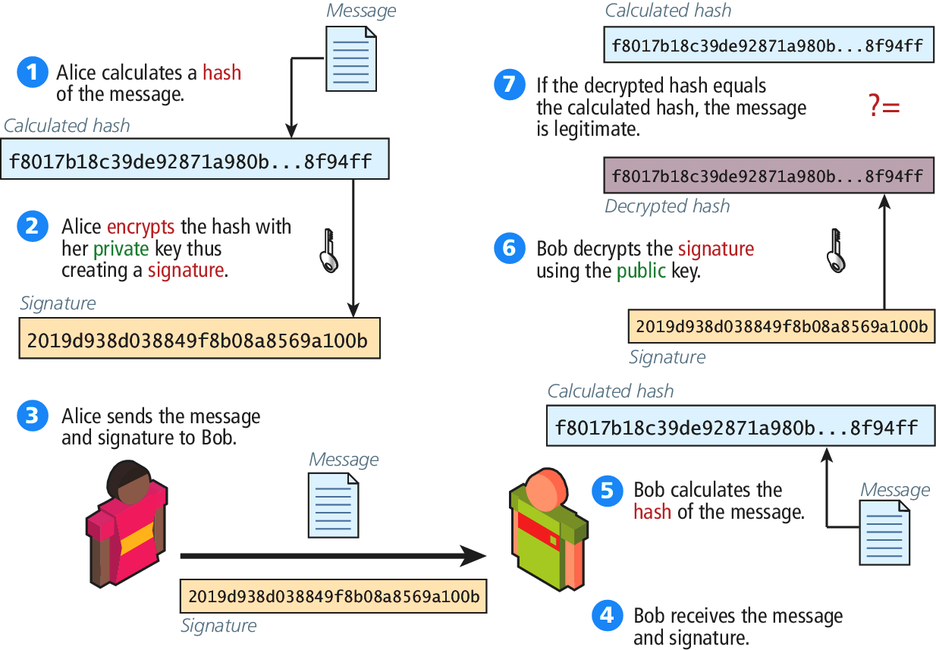
Digital Signatures
Confirming the sender is authentic

Slide 61
Hypertext Transfer Protocol Secure (HTTPS)
Section 4 of 7

Slide 62
HTTPS
Secure HTTP
HTTPS is the HTTP protocol running on top of the Transport Layer Security (TLS).
It’s easy to see from a client’s perspective that a site is secured by the little padlock icons in the URL bar used by most modern browsers

Slide 63
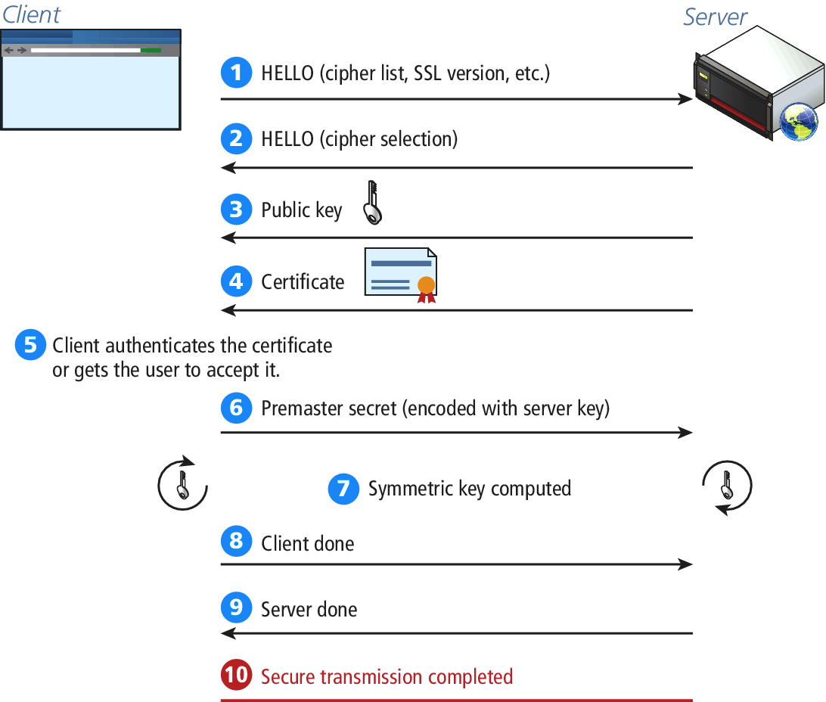
HTTPS
Secure Handshakes

Slide 64
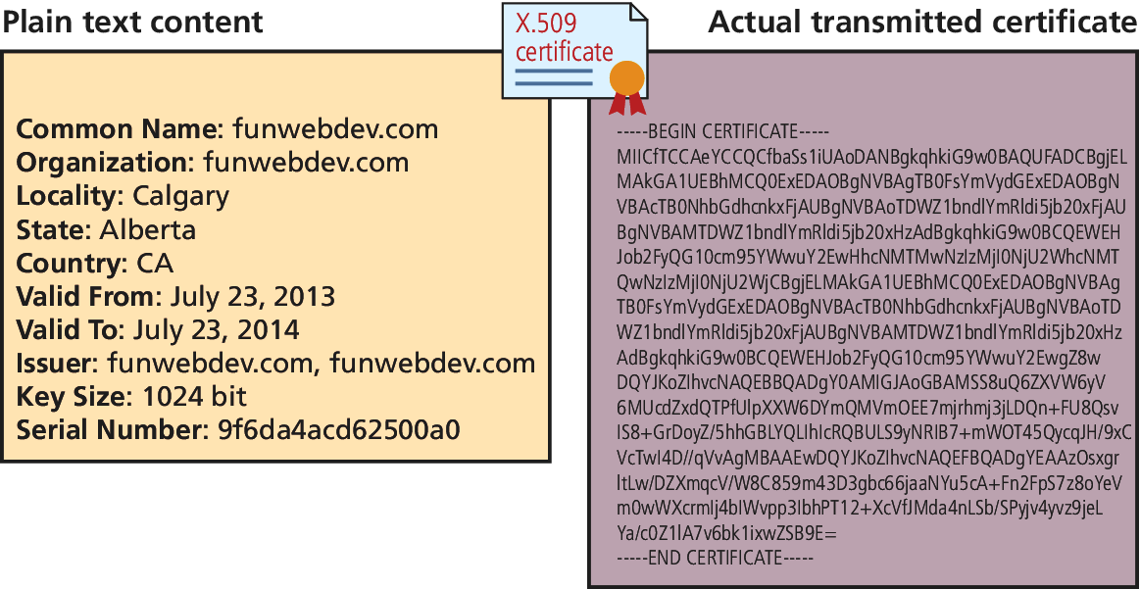
HTTPS
Certificates
The certificate that is transmitted during the handshake is actually an X.509 certificate, which contains many details including the algorithms used, the domain it was issued for, and some public key information.

Slide 65
HTTPS
Certificate Authorities
A Certificate Authority (CA) allows users to place their trust in the certificate since a trusted, independent third party signs it.

Slide 66
HTTPS
Self-Signed Certificates
Self-signed certificates provide the same level of encryption, but the validity of the server is not confirmed.

Slide 67
Security Best Practices
Section 5 of 67

Slide 68
Best Practices
Some good things to do
It’s now time to discuss some practical things you can do to harden your system against attacks
Secure Data Storage
Monitor Your Systems
Audit and Attack Thyself

Slide 69
Secure Data Storage
Not if, but when
Even household names like Sony, Citigroup, Target and GE Money have had their systems breached and data stolen.
If even globally active companies can be impacted, you must ask yourself: when (not if) you are breached, what data will the attacker have access to?

Slide 70
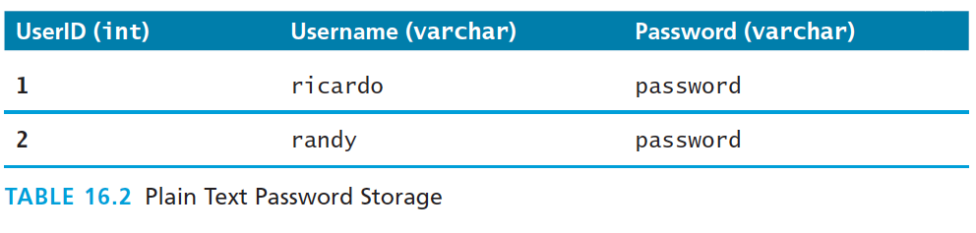
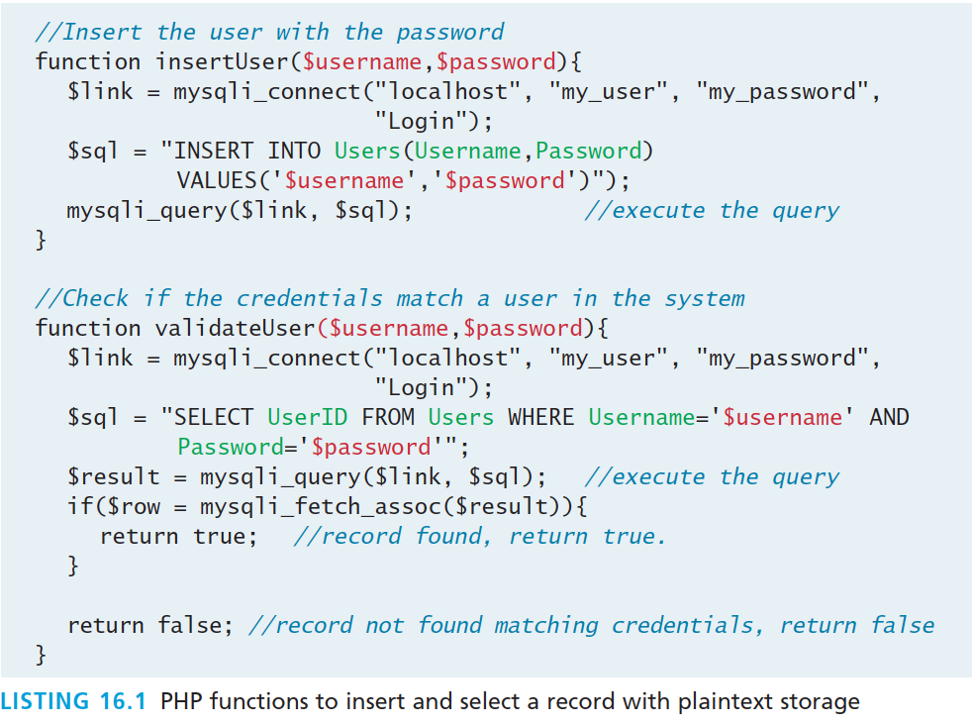
Data Storage
Naïve credential storage example

Slide 71
Data Storage
How can we make it better
Two techniques that improve the integrity of your data.
Secure Hash
Salted Secure Hash

Slide 72
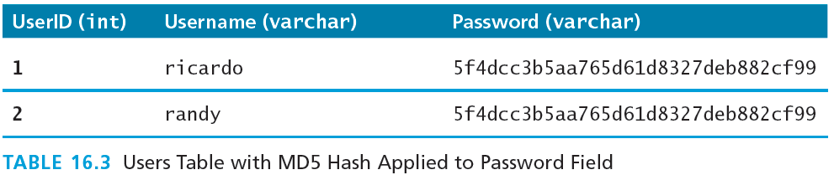
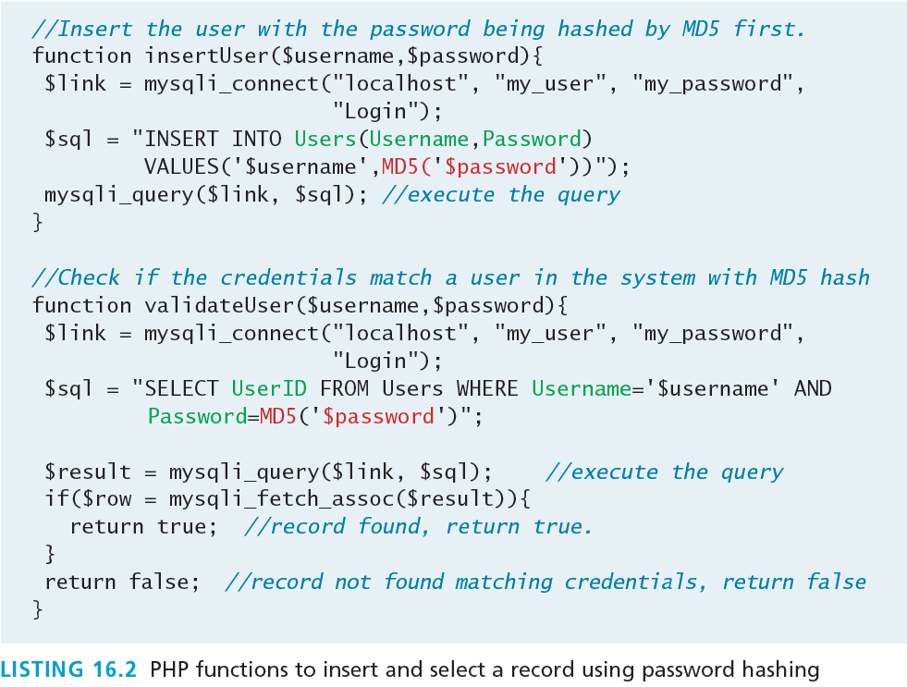
Data Storage
Secure Hash

Slide 73
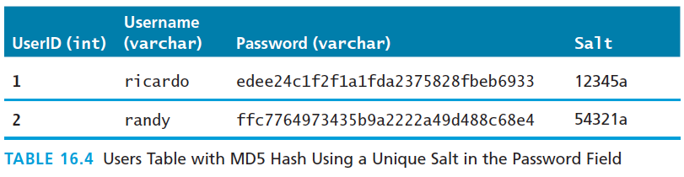
Data Storage
Secure Hash
A simple Google search for the string stored in our newly defined table:
5f4dcc3b5aa765d61d8327deb882cf99 brings up dozens of results which tell you that that string is indeed the MD5 digest for password.
The technique of adding some noise to each password is called salting the password and makes your passwords very secure.

Slide 74
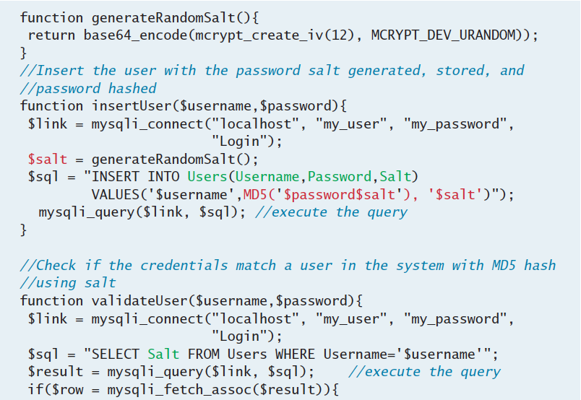
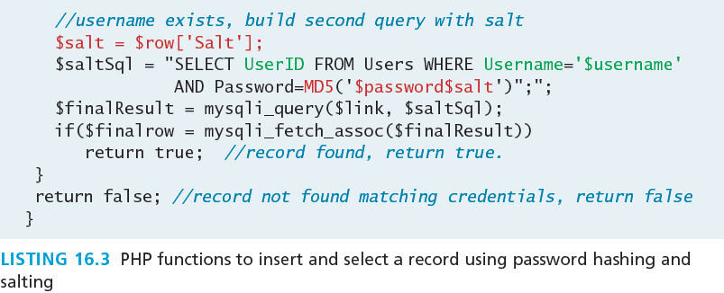
Data Storage
Secure Salted Hash

Slide 75
Monitor Your Systems
You mean manually?
There are tools that allow you to pre-configure a system to check in on all your sites and servers periodically. Nagios, for example, lets you see the status and history of your devices, and sends out notifications by email as per your preferences.

Slide 76
Monitor Your Systems
Systems Monitors
One of the best ways to mitigate damage is to detect an attack as quickly as possible, rather than let an attacker take their time in exploiting your system once inside.
We can detect intrusion
directly by watching login attempts, and
indirectly by watching for suspicious behavior like a web server going down.

Slide 77
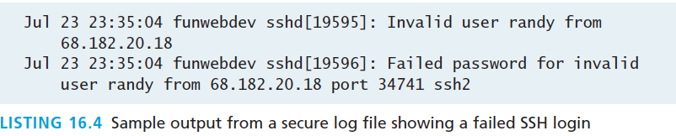
Monitor Your Systems
Access Monitors
As any experienced site administrator will attest, there are thousands of attempted login attempts being performed all day long

Slide 78
Monitor Your Systems
Automated Intrusion Blocking
For those of us less interested in writing that script from scratch, consider the well-tested and widely used
Python script blockhosts.py or
failzban or
blockhostz.
These tools look for failed login attempts by both SSH and FTP and automatically update hosts.deny files as needed.

Slide 79
Audit and Attack Thyself
Only if you own everything
There are a number of companies that you can hire (and grant written permission) to test your servers and report on what they’ve found.
If you prefer to perform your own analysis, you should be aware of some open-source attack tools such as w3af, which provide a framework to test your system including SQL injections, XSS, bad credentials, and more.
It should be noted that performing any sort of analysis on servers you do not have permission to scan could land you a very large jail term

Slide 80
Common Threat Vectors
Section 6 of 6

Slide 81
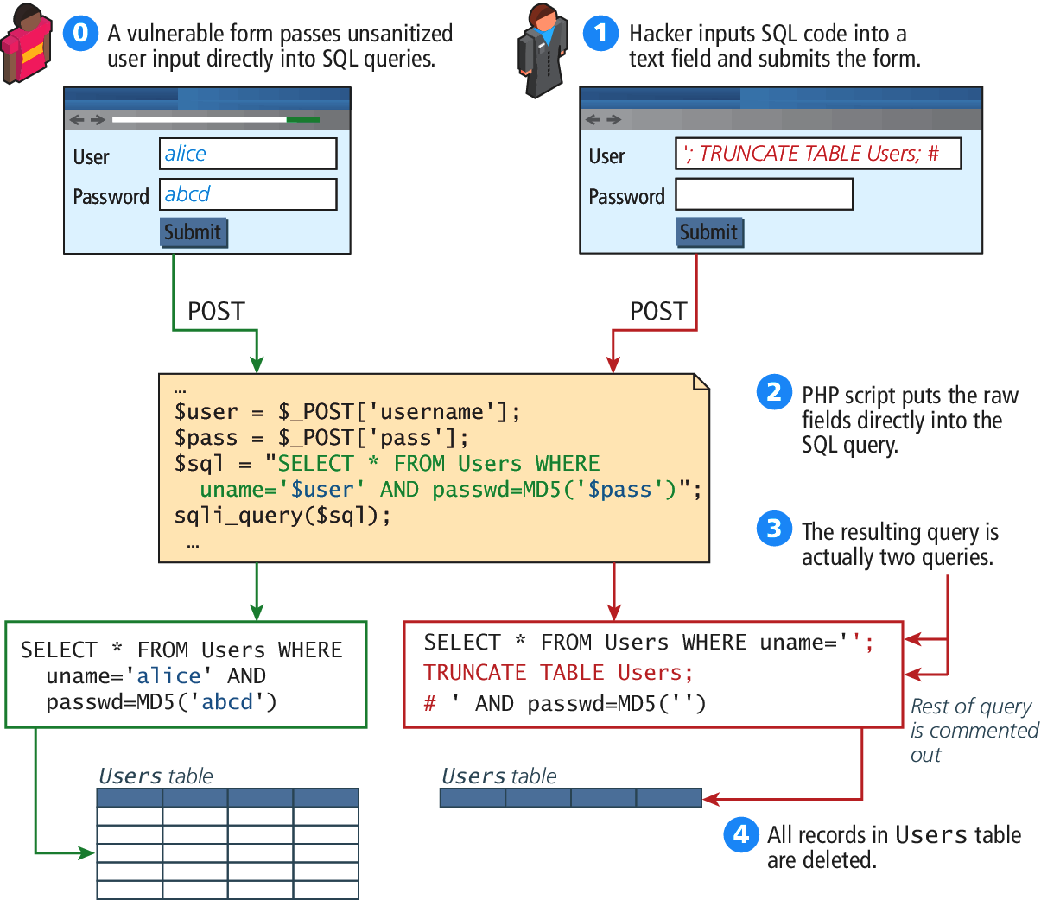
SQL Injection
Using user input fields for evil.

Slide 82
SQL Injection
Using user input fields for evil.
There are two ways to protect against such attacks:
sanitize user input, and
apply the least privileges possible for the application’s database user.

Slide 83
Cross Site Scripting
XSS
In the original formulation for these type of attacks, a malicious user would get a script onto a page and that script would then send data through AJAX to a malicious party, hosted at another domain (hence the cross, in XSS).
There are two main categories of XSS vulnerability:
Reflected XSS
Stored XSS.

Slide 84
Reflected XSS
XSS
Reflected XSS (also known as nonpersistent XSS) are attacks that send malicious content to the server, so that in the server response, the malicious content is embedded.
Consider a login page that outputs a welcome message to the user, based on a GET parameter.
A malicious user could try to put JavaScript into the page by typing the URL:
index.php?User=<script>alert("bad");<script>

Slide 85
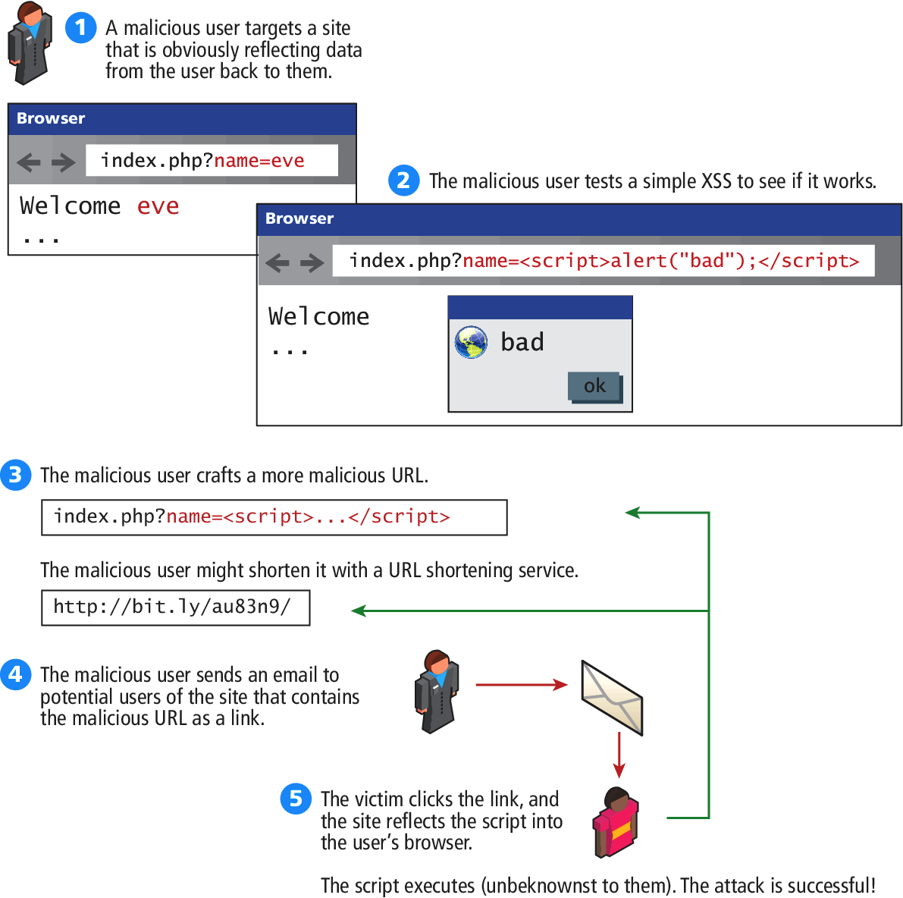
Reflected XSS
XSS

Slide 86
Stored XSS
Another XSS attack
Stored XSS (also known as persistent XSS) is even more dangerous, because the attack can impact every user that visits the site.
Consider a site where users can add comments to existing blog posts. A malicious user could enter a comment that includes malicious JavaScript
The next time anyone logs in, their session cookie can be stolen.

Slide 87
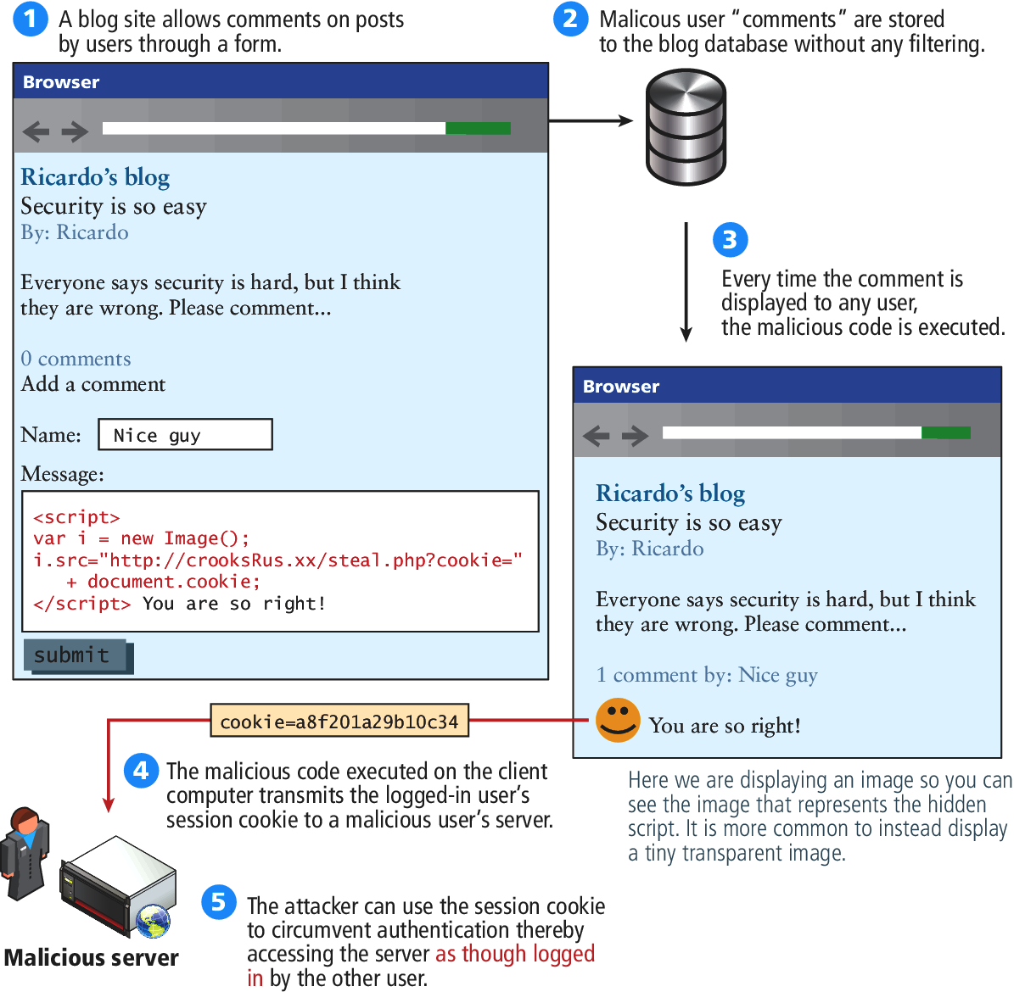
Stored XSS
Another XSS attack

Slide 88
Thwarting XSS
Filter User Input
strip_tags() removes all the HTML tags
But hackers are sophisticated, so libraries such as HTMLPurifier or HTML sanitizer from Google allows you to easily remove a wide range of dangerous characters that could be used as part of an XSS attack
$user= $_POST['uname']; $purifier = new HTMLPurifier(); $clean_user = $purifier->purify($user);

Slide 89
Thwarting XSS
Escape Dangerous content
You may recall HTML escape codes allow characters to be encoded as a code, preceded by &, and ending with a semicolon (e.g., < can be encoded as &lt;).
if you escape the malicious script before sending users would receive the following:
&lt;script&gt;alert(&quot;hello&quot;);&lt;/script&gt;
Which does not get interpreted as JavaScript.
The trick is not to escape everything. Only escape output that originated as user input since that could be a potential XSS attack vector (normally, that’s the content pulled from the database).

Slide 90
Insecure Direct Object Reference
An insecure direct object reference is a fancy name for when some internal value is exposed to the user, and attackers can then manipulate these internal keys to gain access to things they should not have access to.
For instance, if a user can determine that his or her uploaded photos are stored sequentially as /images/99/1.jpg, /images/99/2.jpg, . . . , they might try to access images of other users by requesting
/images/101/1.jpg.

Slide 91
Insecure Direct Object Reference
One strategy for protecting your site against this threat is to obfuscate URLs to use hash values rather than sequential names. For example:
Rather than store images as
1.jpg, 2.jpg . . .
Generate URLs like
9a76eb01c5de4362098.jpg
Using a one way hash.

Slide 92
Insecure Direct Object Reference
Another technique is to route requests for file assets through PHP scripts.
This allows you to add an authorization check for every picture using the $_SESSION variable.

Slide 93
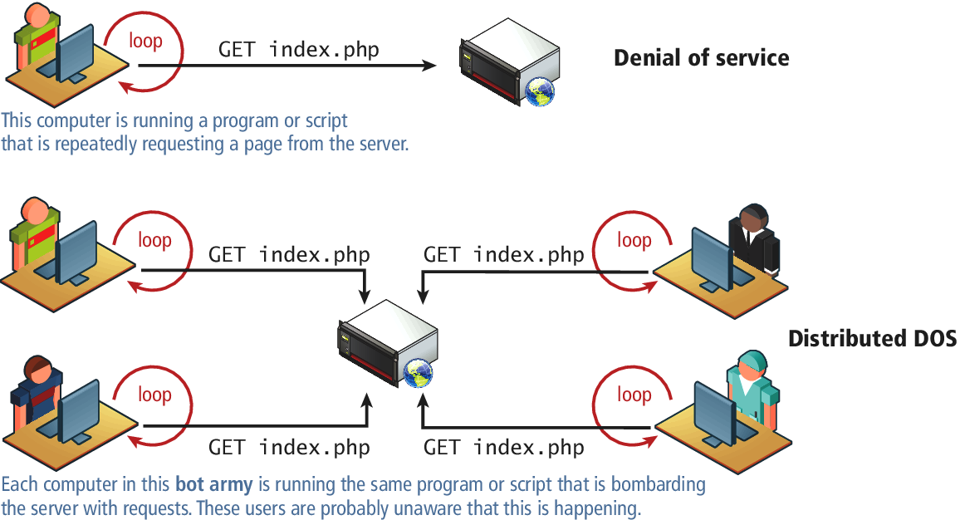
DoS
Denial of Service
Denial of service attacks (DoS attacks) are attacks that aim to overload a server with illegitimate requests in order to prevent the site from responding to legitimate ones.

Slide 94
DDoS
Distributed Denial of Service
Distributed Denial of service attacks have requests coming in from multiple machines, often as part of a bot army of infected machines under the control of a single organization or user

Slide 95
DDoS
Defence
Interestingly, defense against this type of attack is similar to preparation for a huge surge of traffic, that is, caching dynamic pages whenever possible, and ensuring you have the bandwidth needed to respond.
Unfortunately, these attacks are very difficult to counter, as illustrated by a recent attack on the spamhaus servers, which generated 300Gbps worth of requests

Slide 96
Security Misconfiguration
That’s a wide net
There are many systems that can be badly configured:
Out-of-date Software
Open Mail Relays
More Input Attacks
Virtual Open Mail Relay
Arbitrary Program Execution

Slide 97
Out of Date Software
Seems simple enough
Most softwares are regularly updated with new versions that add features, and fix bugs.
Sometimes these updates are not applied, either out of laziness/incompetence, or because they conflict with other software that is running on the system that is not compatible with the new version.
The solution is straightforward: update your software as quickly as possible.

Slide 98
Open Mail Relays
Letting someone send mail as you
An open mail relay refers to any mail server that allows someone to route email through without authentication.
Open relays are troublesome since spammers can use your server to send their messages rather than use their own servers.
This means that the spam messages are sent as if the originating IP address was your own web server! If that spam is flagged at a spam agency like spamhaus, your mail server’s IP address will be blacklisted, and then many mail providers will block legitimate email from you.

Slide 99
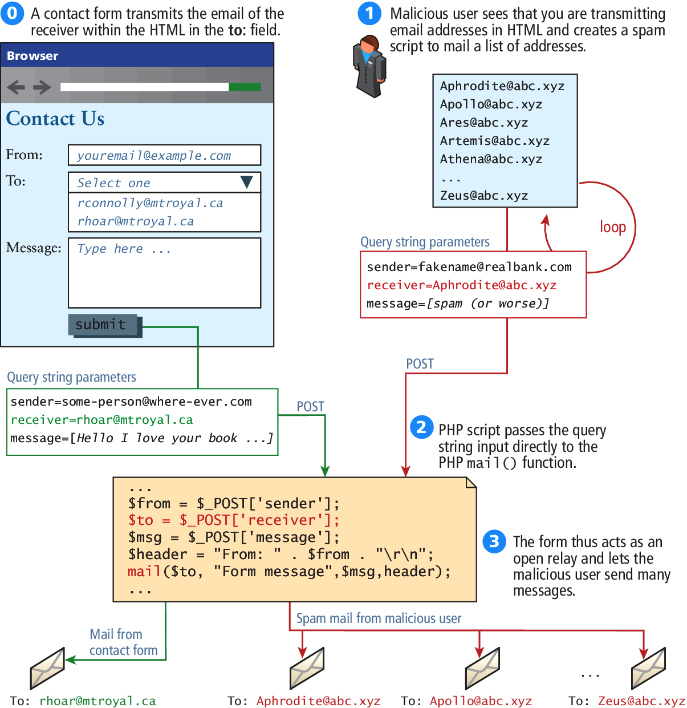
Virtual Open Mail Relays
Letting someone send mail as you despite a closed relay

Slide 100
Virtual Open Mail Relays
Letting someone send mail as you despite a closed relay
By transmitting the email address of the recipient, the contact form is at risk of abuse since an attacker could send to any email they want.
Instead, you should transmit an integer that corresponds to an ID in the user table, thereby requiring the database lookup of a valid recipient.

Slide 101
Arbitrary Program Execution
Let them run any program they want
Another potential attack with user-coupled control relates to running commands in Unix through a PHP script.
Functions like exec(), system(), and passthru() allow the server to run a process as though they were a logged-in user..
To prevent this major class of attack, be sure to
sanitize input, with escapeshellarg() and be mindful of how user input is being passed to the shell.
applying least possible privileges will also help mitigate this attack.

Slide 102
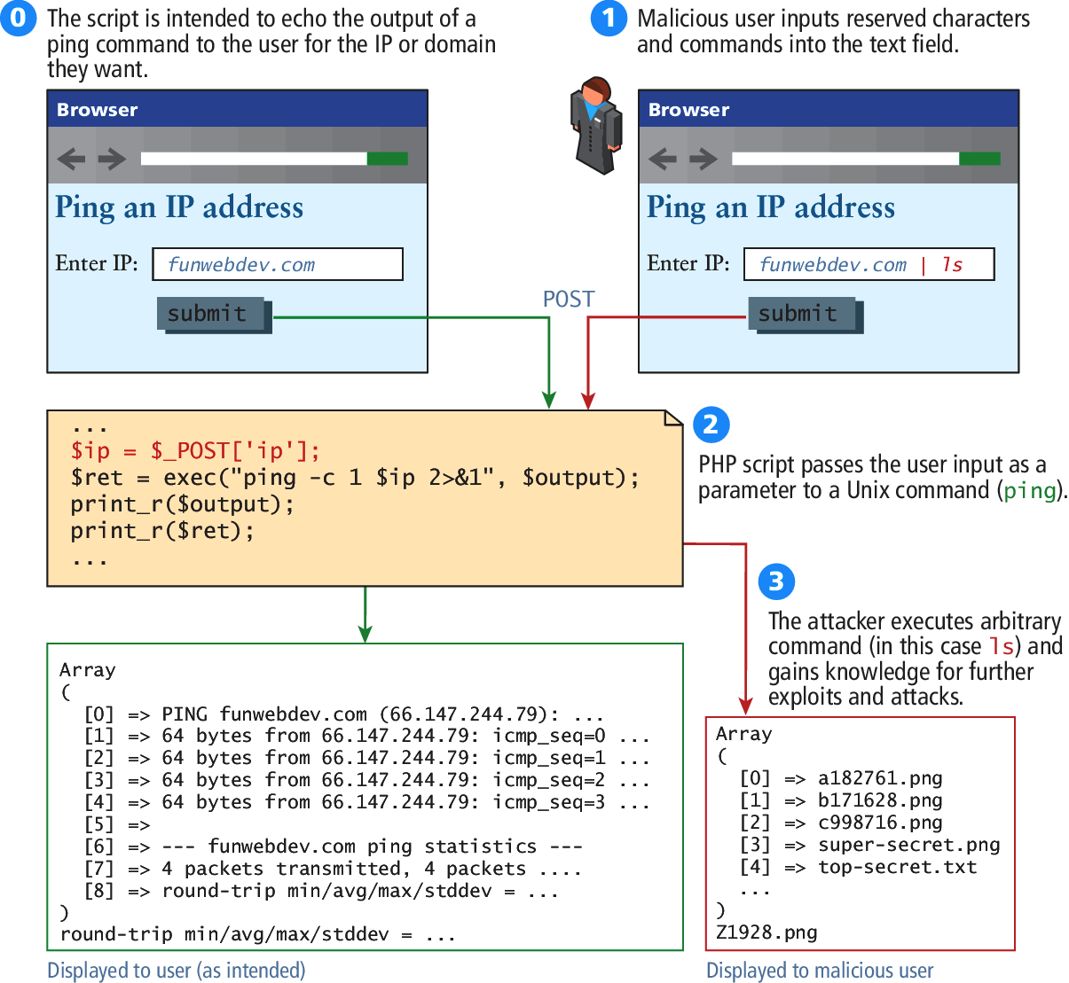
Arbitrary Program Execution
Let them run any program they want

Slide 103
What You’ve Learned
1
2
Security Principles
Authentication
3
4
Cryptography
HTTPS
5
6
Security Best Practices
Common Threat Vectors

